Slide 1
Rock Cut Architecture- Pallavas
Under kings Mahendravarman, (7th Century) Pallavas extended their territories to the Tamil Nadu.
From the time of great Mahendravarman, finest examples of Pallava art were created in Tamil Nadu such as Shore Temple and 7 pagodas of Mahabalipuram.
Mahendravarman successor Narsimhamvaraman was known as “Mamalla” developed This port city was named “Mamallapuram” after Narsimhamvaraman.

Slide 2
The earliest examples of the Pallava art are the rock cut temples of the 7th century AD, while the later examples are of structural temples built in 8th and 9th century.
Mandagapattu rock cut temple
The earliest monument of Mahendravarman was Mandagapattu rock cut temple which was a single rock cut temple built without any wood, brick or metal.
It is located near Villupuram in Tamil Nadu.
This temple has the icons of large Dwarapalas which later became a characteristic of almost all south Indian temples.

Slide 3
Cave Temple – Mandagapattu
Is a very important shrine and holds a considerable position in the history of architecture of South India and of the Pallavas.
An inscription found in the shrine tells us that this is the first cave temple created by Pallava king Mahendravarman I,
This north facing cave shrine has two pillars and two pilasters in its front façade, thus forming three bays.
It is 22 feet in length, 24 feet in width and 9 feet in height.

Slide 4
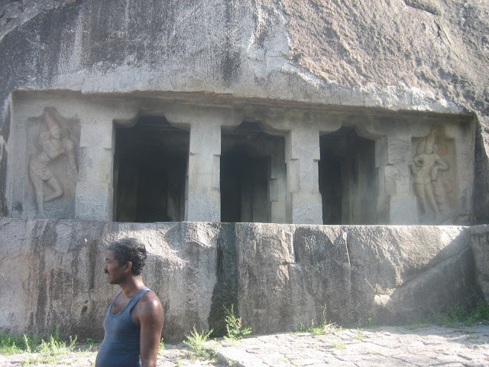
Beyond the pilasters, on either end, are carved two dvarpalas

Slide 5
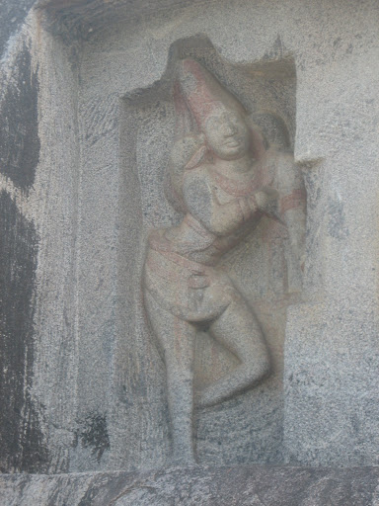
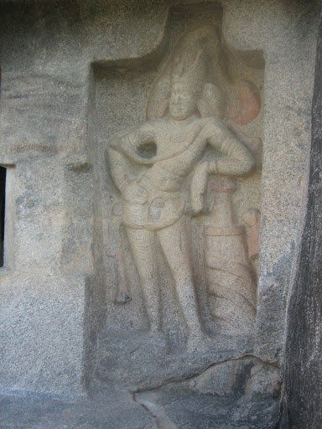

Slide 6
Inscriptions of Mandagapattu –
There is only one inscription found on front pillar of this cave. This Sanskrit language inscription is written in Pallava Grantha script, in Giti metre.
Translation – This brick-less, timber-less, metal-less and mortar-less temple, Lakshita-yatna, which is mansion for the Brahma, Ishvara and Vishnu was caused to be made by the king Vicitra-cita.

Slide 7
Mamandur – Cave Temple
Mamandur and Narasapalaiyam, twin villages, are famous for their four rock-cut cave temples.
From the inscriptions, found in these rock-cut shrines, we find that these two villages are under royal patronage of the Pallavas in sixth-seventh century and the Cholas in eleventh century.
This is one of the closest cave temple site from the Pallava capital at Kanchipuram, which also suggests that probably this might be one of the earliest cave temple as well

Slide 8
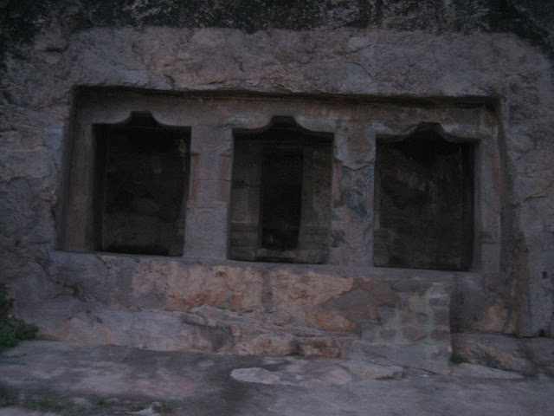
Cave Temple 1

Slide 9
This simple rock-cut shrine faces east and its base is about four feet above the ground.
There are no steps out of the original rock, hence a separate staircase was constructed. Its façade is supported on two pillars and two pilasters.
The pillars are executed in the characteristics Mahendra style while the pilasters are tetragonal all throughout

Slide 10
Dvarapalas of the cave – There are no dvarpalas in this shrine.
Inscription in the cave – The northern wall of the mukha-mandapa has a Pallava Grantha inscription of Mahendravarman I.
Though much of the inscription is damaged, however what is left is very important information.
This inscription talks about a composition of Mahendravarman, Mattavilasaprahasan and provides some birudas (titles) of the same king.

Slide 11
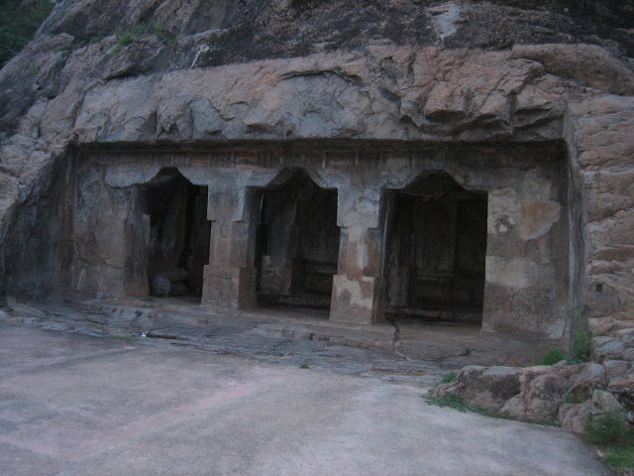
Cave No.2

Slide 12
his cave is located south of the first cave, and faces east.
The front façade is supported on two pillars and two pilasters where pillars are in typical Mahendra style and the pilasters are tetragonal from top to bottom.
Though there is enough space left beyond the pilasters, however no attempt was made to carve dvarpalas.
One reason for not doing this may be that the inner shrines have their own set of dvarpalas.

Slide 13
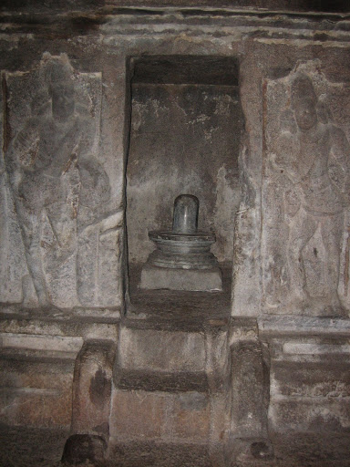

Slide 14
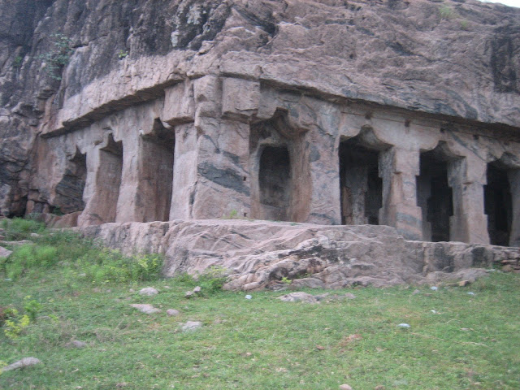
Cave Temple 3

Slide 15
This large excavation, largest among the four on this site, is located south of the previous cave.
There was a plan to excavate a circumambulatory path around the mandapa however it was left unfinished due to instability of the rock.
A similar plan was tried in Pancha Pandava Cave at Mahabalipuram.

Slide 16
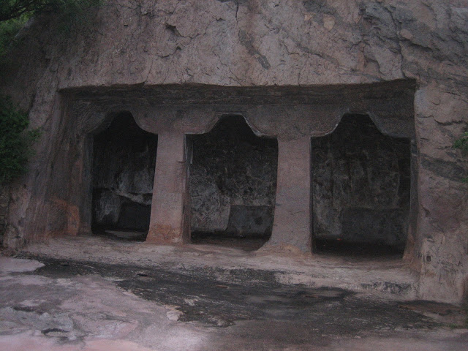
Cave Temple 4

Slide 17
Cave Temples in Trichy
The earliest cave temple of the town, Adi-Varaha Perumal Temple.
This cave temple has portraits of two Pallava kings.
The two royal portrait then represent Simhavishnu, father of Mahendravarman I, in seated posture and Mahendravarman I himself in standing posture
Another interested figure is of Shiva as Gangadhara.
We have one important Gangadhara image at Upper Cave in Trichy.

Slide 18
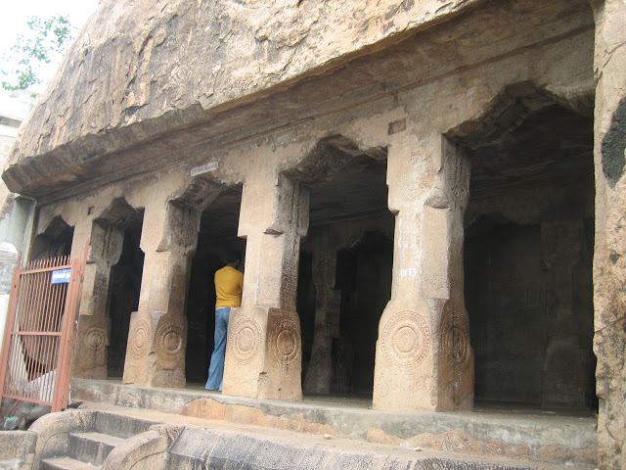

Slide 19
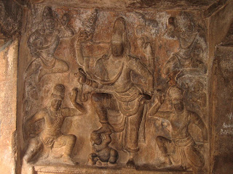

Slide 20
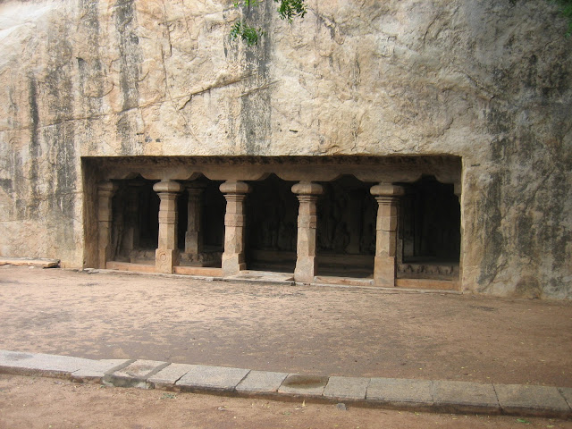
Lower Cave Temple – This cave temple is locally called as Lower Cave Temple and is located near the entrance to the Rockfort complex.

Slide 21
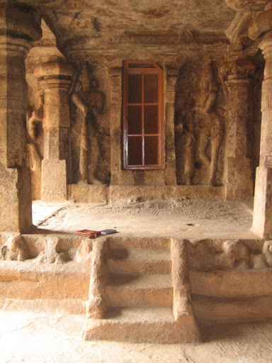
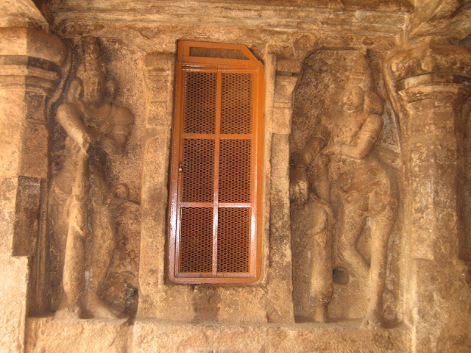
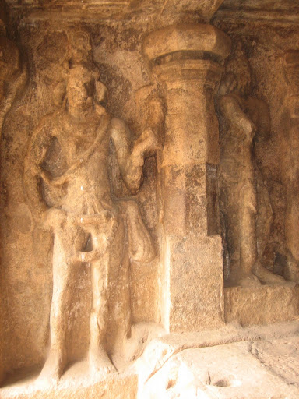

Slide 22
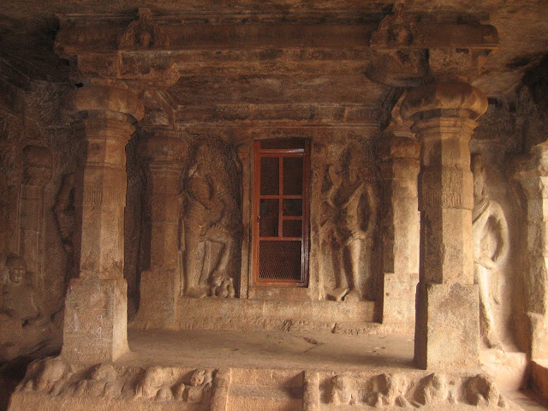

Slide 23
Vilappakkam – Pancha Pandava Malai Cave Temple
Vilappakkam is a small town in near Arcot in Vellore district of Tamilnadu.
The name Pancha Pandava Malai is associated with Pandavas, the heroes of Mahabharata,
One of the largest cave excavation among the Mahendra style caves
This cave is excavated about 4.5 feet above the ground level

Slide 24
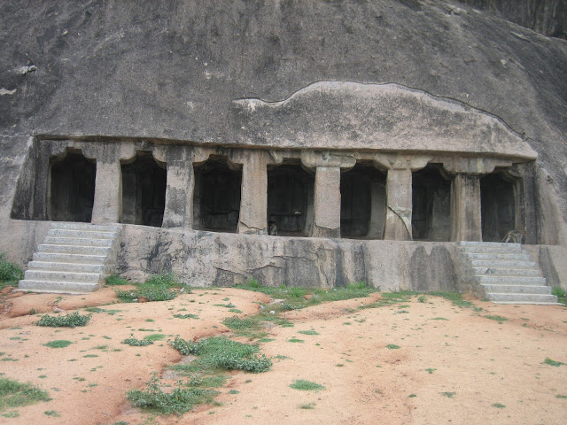

Slide 25
The front façade is supported on six pillars and two pilasters.
This façade is carved little backward from the base.
There seems to be no intention to carve dvarapalas as there is no space left on the sides beyond pilasters.
The pillars are uniformly square from top to bottom.
Pilasters are similar in the style as that of the pillars.
There are curved corbels above the pillars and pilasters, another style mostly seen in Mahendra caves.
Behind this front row of pillars, there is another row of six pillars and two pilasters located half way between the back wall

Slide 26

There are seven niches carved out on the back wall of the cave. The niches are 5.5 feet by 2.5 feet in measurement with the depth of about 1 feet.
All the cells are empty.
There are no dvarapalas carved in this cave. There is no space left, on front façade, beyond the pilasters for the dvarapalas.

Slide 27
Mahendravadi – Vishnu Temple of Mahendravarman
Mahendravadi is a small village situated near to Sholingur railway station. Kanchipuram-Arakkonam road
Its old name seems to be Mahendrapura, which suggests that perhaps this village was founded by Pallava king Mahendravarman I (600-630 CE)
The inscription of Mahendravarman, it is clear that he constructed a tank in this village,

Slide 28
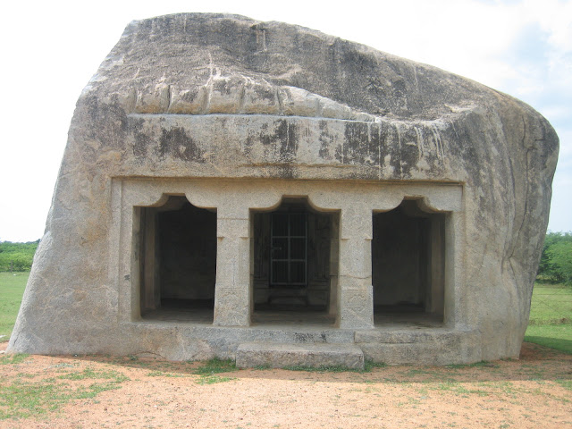

Slide 29
This is a very important cave temple, constructed by Mahendravarman I, as this is the only cave temple which is dedicated to Vishnu
This cave is excavated on a free standing boulder which is about 11 feet long and 25 feet wide from north to south.
The eastern face of this boulder is been cut and excavated into a cave.
The front façade of the cave is supported on two pillars and two pilasters.
Like other caves the pillars of this cave are also cubical on top and bottom with an octagonal intermediate portion.

Slide 30
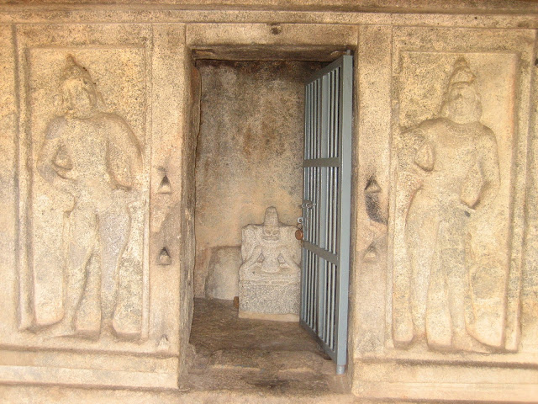

Slide 31
A shrine is carved at the back wall of the cave.
This 11 feet long cell is projecting
At the entrance of the shrine are two dvarpalas, on either side of the entrance.
Interestingly, these two dvarpalas (tribhanga posture). seems to be standing in posture

Slide 32
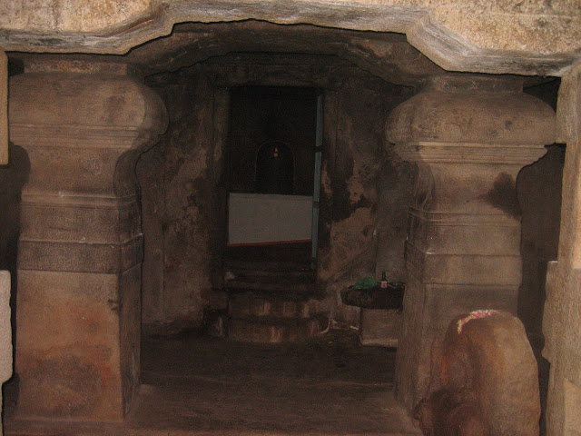
Kudumiyanmalai
Kudumiyamalai is located about 20 km from Puddukkotai town.
The village is centered around a small hillock, where a cave temple has been carved on its foot.
This cave temple, locally known as Melaikkovil,

Slide 33
Excavated on the eastern slope of hillock, this cave temple would have been excavated in early seventh century.
Originally this cave temple was attributed to Pallavas
On south of the mandapa of this cave, on prepared wall of the rock, is carved the celebrated musical inscription.
Inscribed in Pallava Grantha script in Sanskrit language.

Slide 34
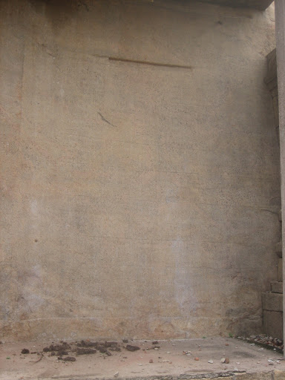

Slide 35
Dalavanur – Satrumalla Pallava Cave Temple
Dalavanur is located about 15 km from Viluppuram and 150 km from Chennai and comes under Viluppuram district.
excavated by Pallava king, Mahendravarman I.
his south facing cave temple is 32 feet in length and excavated about 3.5 feet above the ground level.
The front façade is supported in two pillars and two pilasters.
On the two corners, inside the niches, are two dvarpalas

Slide 36
